Slide 1
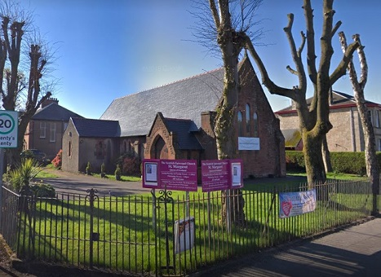
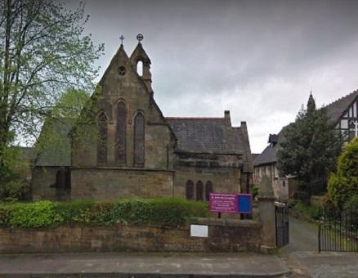
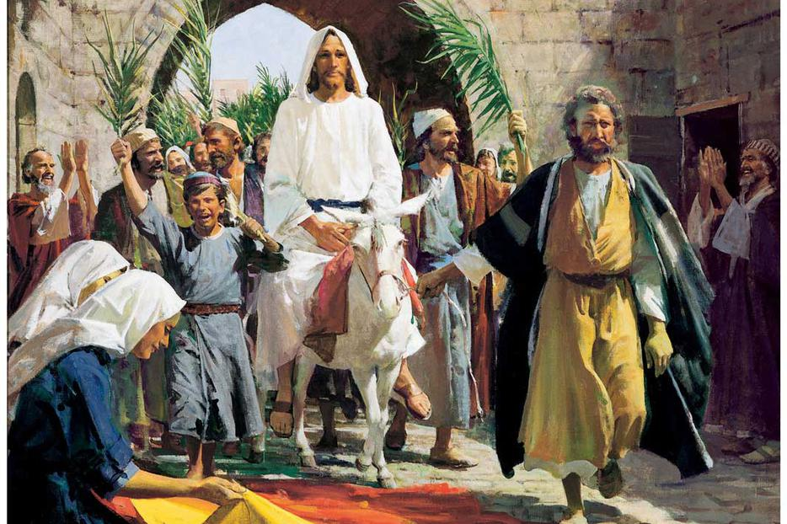
Evensong Sunday 28 March 2021 Palm Sunday
St Johns Johnstone & St Margarets Renfrew
Scottish Episcopal Church
Diocese of Glasgow & Galloway

Slide 2
MUTE and sing along at home

Slide 3
UNMUTE for the Sentences
Is it nothing to you, all ye that pass by? Behold, and see if there be any sorrow like unto my sorrow.
Lamentations 1. 12
.

Slide 4
Exhortation
DEARLY beloved brethren, the Scripture moveth us in sundry places to acknowledge and confess our manifold sins and wickedness; and that we should not dissemble nor cloke them before the face of Almighty God our heavenly Father; but confess them with an humble, lowly, penitent, and obedient heart; to the end that we may obtain forgiveness of the same, by his infinite goodness and mercy. And although we ought at all times humbly to acknowledge our sins before God; yet ought we most chiefly so to do, when we assemble and meet together to render thanks for the great benefits that we have received at his hands, to set forth his most worthy praise, to hear his most holy word, and to ask those things which are requisite and necessary, as well for the body as the soul. Wherefore I pray and beseech you, as many as are here present, to accompany me with a pure heart and humble voice unto the throne of the heavenly grace, saying after me:

Slide 5
ALMIGHTY and most merciful Father, We have erred and strayed from thy ways like lost sheep, We have followed too much the devices and desires of our own hearts, We have offended against thy holy laws, We have left undone those things which we ought to have done, And we have done those things which we ought not to have done, And there is no health in us: But thou, O Lord, have mercy upon us miserable offenders; Spare thou them, O God, which confess their faults, Restore thou them that are penitent, According to thy promises declared unto mankind in Christ Jesu our Lord: And grant, O most merciful Father, for his sake, That we may hereafter live a godly, righteous, and sober life, To the glory of thy holy Name. Amen.

Slide 6
ALMIGHTY God, the Father of our Lord Jesus Christ, who desireth not the death of a sinner, but rather that he may turn from his wickedness and live; and hath given power and commandment to his Ministers, to declare and pronounce to his people, being penitent, the Absolution and Remission of their sins: He pardoneth and absolveth all them that truly repent and unfeignedly believe his holy Gospel. Wherefore let us beseech him to grant us true repentance and his Holy Spirit, that those things may please him which we do at this present, and that the rest of our life hereafter may be pure and holy; so that at the last we may come to his eternal joy; through Jesus Christ our Lord. Amen.

Slide 7
The responses
O LORD, open thou our lips; And our mouth shall shew forth thy praise.
O God, make speed to save us; O Lord, make haste to help us.
Glory be to the Father, and to the Son : and to the Holy Ghost; As it was in the beginning, is now, and ever shall be : world without end. Amen.
Praise ye the Lord;
The Lord’s Name be praised.

Slide 8
MUTE - sing along with the psalm at home
Psalm 31.1-5,15-16

Slide 9
Zechariah 12:9-11, 13:1, 7-9
The Old Testament lesson is written in the 12th chapter of the prophet Zechariah beginning to read at the 9th verse.
The Lord spoke saying,
And on that day I will seek to destroy all the nations that come against Jerusalem.
And I will pour out a spirit of compassion and supplication on the house of David and the inhabitants of Jerusalem, so that, when they look on the one* whom they have pierced, they shall mourn for him, as one mourns for an only child, and weep bitterly over him, as one weeps over a firstborn. On that day the mourning in Jerusalem will be as great as the mourning for Hadad-rimmon in the plain of Megiddo.
On that day a fountain shall be opened for the house of David and the inhabitants of Jerusalem, to cleanse them from sin and impurity.
‘Awake, O sword, against my shepherd, against the man who is my associate,’
says the Lord of hosts. Strike the shepherd, that the sheep may be scattered; I will turn my hand against the little ones. In the whole land, says the Lord, two-thirds shall be cut off and perish, and one-third shall be left alive. And I will put this third into the fire, refine them as one refines silver, and test them as gold is tested. They will call on my name, and I will answer them. I will say, ‘They are my people’; and they will say, ‘The Lord is our God.’
Here ends the Old Testament lesson

Slide 10
‘Awake, O sword, against my shepherd, against the man who is my associate,’
says the Lord of hosts. Strike the shepherd, that the sheep may be scattered; I will turn my hand against the little ones. In the whole land, says the Lord, two-thirds shall be cut off and perish, and one-third shall be left alive. And I will put this third into the fire, refine them as one refines silver, and test them as gold is tested. They will call on my name, and I will answer them. I will say, ‘They are my people’; and they will say, ‘The Lord is our God.’
Here ends the Old Testament lesson

Slide 11
Magnificat
My soul doth | magni-fy the | Lord : and my spirit hath | rejoiced . in | God my | Saviour. For he | hath re- | garded : the | lowli-ness | of his | handmaiden. For be- | hold, from | henceforth : all gener- | ations . shall | call me | blessed. For he that is mighty hath | magni-fied | me : and | holy | is his | Name. And his mercy is on | them that | fear him : through- | out all | gener- | ations. He hath shewed | strength . with his | arm : he hath scattered the proud in the imagi- | nation | of their | hearts. He hath put down the | mighty . from their | seat : and hath ex- | alted . the | humble . and | meek. He hath filled the hungry with | good | things : and the rich he | hath sent | empty . a - |way. He re- | membering . his | mercy : hath | holpen . his | servant | Israel, As he promised to | our fore- | fathers : Abraham | and his | seed for | ever. GLORIA

Slide 12
Matthew 21:12-17
The New testament lesson is written in the 21st chapter of the gospel of St Matthew beginning to read at the 12th verse
Then Jesus entered the temple* and drove out all who were selling and buying in the temple, and he overturned the tables of the money-changers and the seats of those who sold doves. He said to them, ‘It is written, “My house shall be called a house of prayer”; but you are making it a den of robbers.’
The blind and the lame came to him in the temple, and he cured them. But when the chief priests and the scribes saw the amazing things that he did, and heard* the children crying out in the temple, ‘Hosanna to the Son of David’, they became angry and said to him, ‘Do you hear what these are saying?’ Jesus said to them, ‘Yes; have you never read, “Out of the mouths of infants and nursing babies you have prepared praise for yourself”?’
He left them, went out of the city to Bethany, and spent the night there.
Here ends the New testament lesson

Slide 13
He left them, went out of the city to Bethany, and spent the night there.
Here ends the New testament lesson

Slide 14
Nunc Dimittis
1 Lord, now lettest thou thy servant de- | part in | peace :
ac- | cording | to thy | word.
2 For mine eyes have seen | thy sal- | vation :
which thou hast pre- | pared be-fore the | face . of all | people.
3 To be a light to | lighten . the | Gentiles :
and to be the | glory . of thy | people | Israel.
GLORIA

Slide 15
I BELIEVE in God the Father Almighty, Maker of heaven and earth: And in Jesus Christ his only Son our Lord, Who was conceived by the holy Ghost, Born of the Virgin Mary, Suffered under Pontius Pilate, Was crucified, dead, and buried: He descended into hell. The third day he rose again from the dead; He ascended into heaven, And sitteth on the right hand of God the Father Almighty; From thence he shall come to judge the quick and the dead. I believe in the Holy Ghost; The holy Catholic Church; The Communion of Saints; The Forgiveness of sins; The Resurrection of the body, And the Life everlasting. Amen.

Slide 16
responses
The Lord be with you;
And with thy spirit.
Let us pray.
Lord, have mercy upon us.
Christ, have mercy upon us.
Lord, have mercy upon us.

Slide 17
Lord’s Prayer
OUR Father which art in heaven, Hallowed be thy Name, Thy kingdom come, Thy will be done, in earth as it is in heaven. Give us this day our daily bread; And forgive us our trespasses, As we forgive them that trespass against us; And lead us not into temptation, But deliver us from evil. Amen.

Slide 18
Versicles
O Lord, shew thy mercy upon us; And grant us thy salvation.
O Lord, save the Queen; And mercifully hear us when we call upon thee.
Endue thy Ministers with righteousness; And make thy chosen people joyful.
O Lord, save thy people; And bless thine inheritance.
Give peace in our time, O Lord;
Because there is none other that fighteth for us, but only thou, O God.
O God, make clean our hearts within us; And take not thy Holy Spirit from us.
.

Slide 19
Collect of the Day
Collect for Palm Sunday
ALMIGHTY and Everlasting God, who, of thy tender love towards mankind, hast sent thy Son our Saviour Jesus Christ, to take upon him our flesh, and to suffer death upon the cross, that all mankind should follow the example of his great humility: Mercifully grant that we may both follow the example of his patience, and also be made partakers of his resurrection; through the same Jesus Christ our Lord. Amen.

Slide 20
Second Collect
O GOD, from whom all holy desires, all good counsels, and all just works do proceed: Give unto thy servants that peace which the world cannot give; that both our hearts may be set to obey thy commandments, and also that by thee we being defended from the fear of our enemies may pass our time in rest and quietness; through the merits of Jesus Christ our Saviour. Amen.

Slide 21
THIRD Collect together
LIGHTEN our darkness, we beseech thee, O Lord;
and by thy great mercy defend us
from all perils and dangers of this night;
for the love of thy only Son,
our Saviour Jesus Christ. Amen.

Slide 22
MUTE yourself and feel free to join in

Slide 23
Let us pray for the Queen, and all who are set in authority under her throughout her dominions.
V. The King shall rejoice in thy strength, O Lord; R. Exceeding glad shall he be of thy salvation.
ALMIGHTY God, who reignest over the kingdoms of men: We humbly beseech thee to bless our Sovereign Lady, Queen Elizabeth, her Ministers and Parliaments, and all who are set in authority under her throughout her dominions; that they may order all things in wisdom and righteousness, to the honour of thy holy Name, and the good of thy Church and people; through Jesus Christ our Lord. Amen.

Slide 24
Let us pray for the unity of all Christian people.
V. Behold, how good and joyful a thing it is; R. To dwell together in unity.
O GOD the Father of our Lord Jesus Christ, our only Saviour, the Prince of Peace: Give us grace seriously to lay to heart the great dangers we are in by our unhappy divisions. Take away all hatred and prejudice, and whatsoever else may hinder us from godly union and concord: that, as there is but one Body, and one Spirit, and one hope of our calling, one Lord, one Faith, one Baptism, one God and Father of us all, so we may henceforth be all of one heart, and of one soul, united in one holy bond of truth and peace, of faith and charity, and may with one mind and one mouth glorify thee; through Jesus Christ our Lord. Amen.

Slide 25
Let us pray for the extension of Christ’s kingdom throughout the world.
V. How beautiful are the feet of them that preach the gospel of peace; R. And bring glad tidings of good things.
O GOD our heavenly Father, who didst manifest thy love by sending thine only-begotten Son into the world that all might live through him: Pour thy Spirit upon thy Church that it may fulfil his command to make disciples of all the nations; send forth, we beseech thee, labourers into thy harvest; and hasten the time when the fulness of the Gentiles shall be gathered in, and all Israel shall be saved; through the same thy Son Jesus Christ our Lord. Amen.

Slide 26
V. Desire of me, and I shall give thee the heathen for thine inheritance; R. And the utmost parts of the earth for thy possession.
O GOD, who hast made of one blood all nations of men for to dwell on all the face of the earth, and didst send thy blessed Son to preach peace to them that are afar off and to them that are nigh: Grant that the people who sit in darkness and the shadow of death may feel after thee and find thee; and hasten, O Lord, the fulfilment of thy promise to pour out thy Spirit upon all flesh; through Jesus Christ our Lord. Amen.

Slide 27
Let us pray for the sick and suffering.
V. He healeth those that are broken in heart;
R. And giveth medicine to heal their sickness.
ALMIGHTY and immortal God, giver of life and health: We beseech thee to hear our prayers for thy servants for whom we implore thy mercy, that by thy blessing upon them and upon those who minister to them of thy healing gifts, they may be restored, if it be thy gracious will, to soundness of health, and give thanks to thee in thy holy Church; through Jesus Christ our Lord. Amen.
Here may follow any of the Additional Prayers as need may require.

Slide 28
Let us remember before God the faithful departed.
V. The souls of the righteous are in the hand of God;
R. They are in peace.
O ETERNAL Lord God, who holdest all souls in life: We beseech thee to shed forth upon all the faithful departed the bright beams of thy light and heavenly comfort; and grant that they, and we with them, may at length attain to the joys of thine eternal kingdom; through Jesus Christ our Lord. Amen.
We offer our personal prayers in silence

Slide 29
TO God the Father who loved us, and made us accepted in the Beloved; to God the Son, who loved us, and loosed us from our sins by his own blood; to God the Holy Ghost who sheddeth the love of God abroad in our hearts; to the one true God be all love and all glory for time and for eternity. Amen.
The Almighty and merciful God bless and keep us this night, and for evermore. Amen.

Slide 30
MUTE and sing along at home

Slide 31
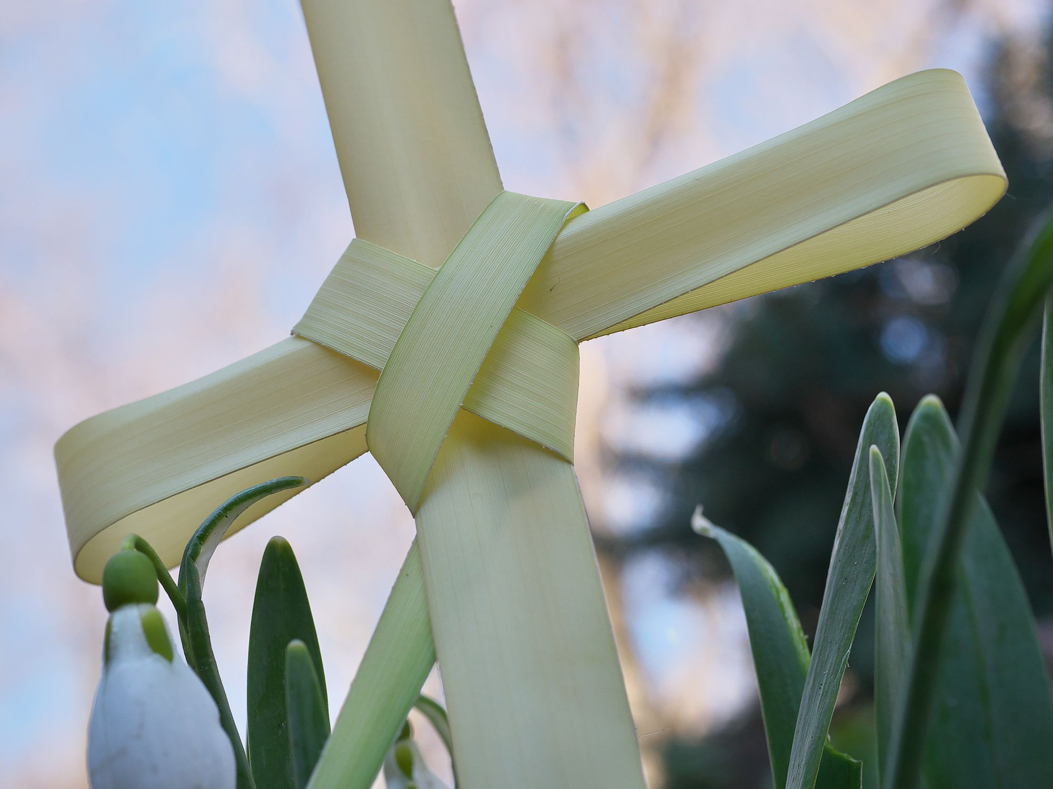
Thank you for joining in Palm Sunday Evensong this week is Holy Week links to all Holy Week services are on the website www.SECStJohnStMargaret.org.uk
Feel free to go, or stay and chat

