Slide 1
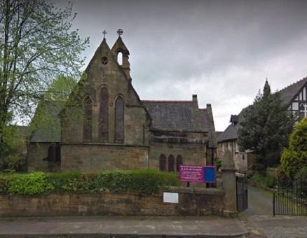
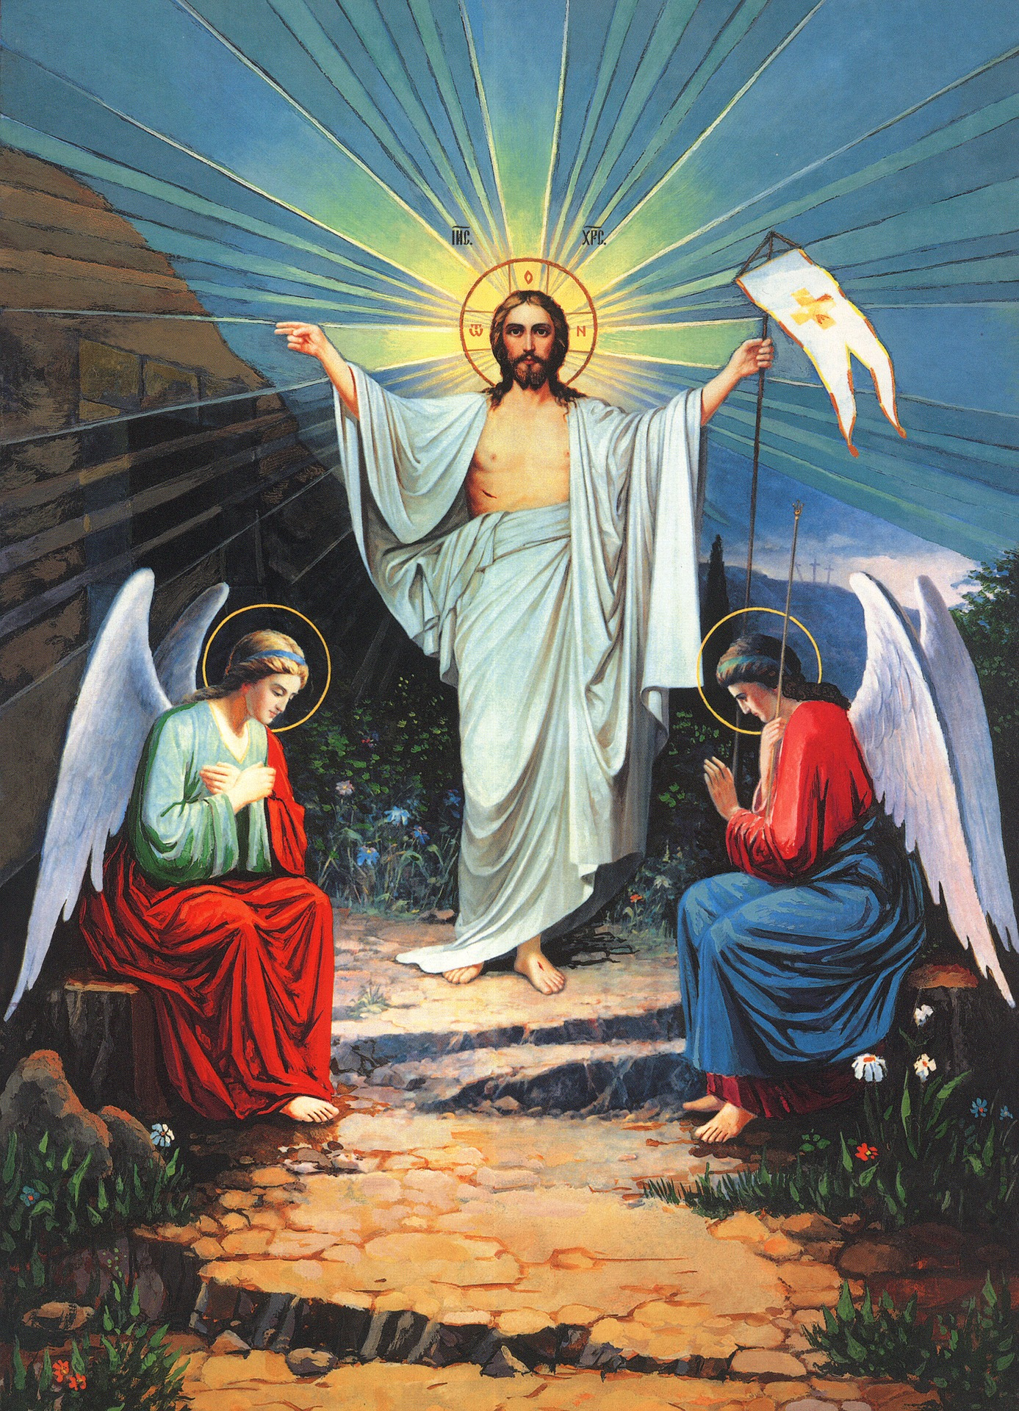
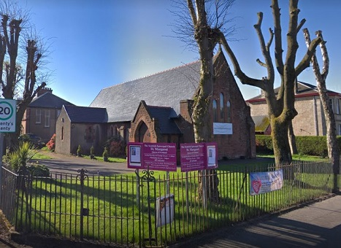
Evensong Sunday 11 April 2021 Easter 2
St Johns Johnstone & St Margarets Renfrew
Scottish Episcopal Church
Diocese of Glasgow & Galloway

Slide 2
MUTE and sing to the music at home

Slide 3
UNMUTE for the Sentences
The Lord is risen indeed. Alleluia.
St. Luke 24. 34.
Blessed be the God and Father of our Lord Jesus Christ, who according to his great mercy hath begotten us again unto a living hope by the resurrection of Jesus Christ from the dead.
1 St. Peter 1. 3.

Slide 4
Exhortation
DEARLY beloved brethren, the Scripture moveth us in sundry places to acknowledge and confess our manifold sins and wickedness; and that we should not dissemble nor cloke them before the face of Almighty God our heavenly Father; but confess them with an humble, lowly, penitent, and obedient heart; to the end that we may obtain forgiveness of the same, by his infinite goodness and mercy. And although we ought at all times humbly to acknowledge our sins before God; yet ought we most chiefly so to do, when we assemble and meet together to render thanks for the great benefits that we have received at his hands, to set forth his most worthy praise, to hear his most holy word, and to ask those things which are requisite and necessary, as well for the body as the soul. Wherefore I pray and beseech you, as many as are here present, to accompany me with a pure heart and humble voice unto the throne of the heavenly grace, saying after me:

Slide 5
ALMIGHTY and most merciful Father, We have erred and strayed from thy ways like lost sheep, We have followed too much the devices and desires of our own hearts, We have offended against thy holy laws, We have left undone those things which we ought to have done, And we have done those things which we ought not to have done, And there is no health in us: But thou, O Lord, have mercy upon us miserable offenders; Spare thou them, O God, which confess their faults, Restore thou them that are penitent, According to thy promises declared unto mankind in Christ Jesu our Lord: And grant, O most merciful Father, for his sake, That we may hereafter live a godly, righteous, and sober life, To the glory of thy holy Name. Amen.

Slide 6
ALMIGHTY God, the Father of our Lord Jesus Christ, who desireth not the death of a sinner, but rather that he may turn from his wickedness and live; and hath given power and commandment to his Ministers, to declare and pronounce to his people, being penitent, the Absolution and Remission of their sins: He pardoneth and absolveth all them that truly repent and unfeignedly believe his holy Gospel. Wherefore let us beseech him to grant us true repentance and his Holy Spirit, that those things may please him which we do at this present, and that the rest of our life hereafter may be pure and holy; so that at the last we may come to his eternal joy; through Jesus Christ our Lord. Amen.

Slide 7
The responses
O LORD, open thou our lips; And our mouth shall shew forth thy praise.
O God, make speed to save us; O Lord, make haste to help us.
Glory be to the Father, and to the Son : and to the Holy Ghost; As it was in the beginning, is now, and ever shall be : world without end. Amen.
Praise ye the Lord; The Lord’s Name be praised.

Slide 8
MUTE - sing along with the psalm 143 at home

Slide 9
Daniel 6:6-23
The Old Testament lesson is written in the 6th chapter of the book of Daniel beginning to read at the 6th verse
So the presidents and satraps conspired and came to the king and said to him, ‘O King Darius, live for ever! All the presidents of the kingdom, the prefects and the satraps, the counsellors and the governors, are agreed that the king should establish an ordinance and enforce an interdict, that whoever prays to anyone, divine or human, for thirty days, except to you, O king, shall be thrown into a den of lions. Now, O king, establish the interdict and sign the document, so that it cannot be changed, according to the law of the Medes and the Persians, which cannot be revoked.’ Therefore King Darius signed the document and interdict.
Although Daniel knew that the document had been signed, he continued to go to his house, which had windows in its upper room open towards Jerusalem, and to get down on his knees three times a day to pray to his God and praise him, just as he had done previously. The conspirators came and found Daniel praying and seeking mercy before his God.
Then they approached the king and said concerning the interdict, ‘O king! Did you not sign an interdict, that anyone who prays to anyone, divine or human, within thirty days except to you, O king, shall be thrown into a den of lions?’ The king answered, ‘The thing stands fast, according to the law of the Medes and Persians, which cannot be revoked.’ Then they responded to the king, ‘Daniel, one of the exiles from Judah, pays no attention to you, O king, or to the interdict you have signed, but he is saying his prayers three times a day.’
When the king heard the charge, he was very much distressed. He was determined to save Daniel, and until the sun went down he made every effort to rescue him. Then the conspirators came to the king and said to him, ‘Know, O king, that it is a law of the Medes and Persians that no interdict or ordinance that the king establishes can be changed.’
Then the king gave the command, and Daniel was brought and thrown into the den of lions. The king said to Daniel, ‘May your God, whom you faithfully serve, deliver you!’ A stone was brought and laid on the mouth of the den, and the king sealed it with his own signet and with the signet of his lords, so that nothing might be changed concerning Daniel. Then the king went to his palace and spent the night fasting; no food was brought to him, and sleep fled from him.
Then, at break of day, the king got up and hurried to the den of lions. When he came near the den where Daniel was, he cried out anxiously to Daniel, ‘O Daniel, servant of the living God, has your God whom you faithfully serve been able to deliver you from the lions?’ Daniel then said to the king, ‘O king, live for ever! My God sent his angel and shut the lions’ mouths so that they would not hurt me, because I was found blameless before him; and also before you, O king, I have done no wrong.’ Then the king was exceedingly glad and commanded that Daniel be taken up out of the den. So Daniel was taken up out of the den, and no kind of harm was found on him, because he had trusted in his God.
Here ends the OT lesson

Slide 10
Then they approached the king and said concerning the interdict, ‘O king! Did you not sign an interdict, that anyone who prays to anyone, divine or human, within thirty days except to you, O king, shall be thrown into a den of lions?’ The king answered, ‘The thing stands fast, according to the law of the Medes and Persians, which cannot be revoked.’ Then they responded to the king, ‘Daniel, one of the exiles from Judah, pays no attention to you, O king, or to the interdict you have signed, but he is saying his prayers three times a day.’
When the king heard the charge, he was very much distressed. He was determined to save Daniel, and until the sun went down he made every effort to rescue him. Then the conspirators came to the king and said to him, ‘Know, O king, that it is a law of the Medes and Persians that no interdict or ordinance that the king establishes can be changed.’
Then the king gave the command, and Daniel was brought and thrown into the den of lions.
The king said to Daniel, ‘May your God, whom you faithfully serve, deliver you!’ A stone was brought and laid on the mouth of the den, and the king sealed it with his own signet and with the signet of his lords, so that nothing might be changed concerning Daniel. Then the king went to his palace and spent the night fasting; no food was brought to him, and sleep fled from him.
Then, at break of day, the king got up and hurried to the den of lions. When he came near the den where Daniel was, he cried out anxiously to Daniel, ‘O Daniel, servant of the living God, has your God whom you faithfully serve been able to deliver you from the lions?’ Daniel then said to the king, ‘O king, live for ever! My God sent his angel and shut the lions’ mouths so that they would not hurt me, because I was found blameless before him; and also before you, O king, I have done no wrong.’ Then the king was exceedingly glad and commanded that Daniel be taken up out of the den. So Daniel was taken up out of the den, and no kind of harm was found on him, because he had trusted in his God.
Here ends the OT lesson

Slide 11
The king said to Daniel, ‘May your God, whom you faithfully serve, deliver you!’ A stone was brought and laid on the mouth of the den, and the king sealed it with his own signet and with the signet of his lords, so that nothing might be changed concerning Daniel. Then the king went to his palace and spent the night fasting; no food was brought to him, and sleep fled from him.
Then, at break of day, the king got up and hurried to the den of lions. When he came near the den where Daniel was, he cried out anxiously to Daniel, ‘O Daniel, servant of the living God, has your God whom you faithfully serve been able to deliver you from the lions?’ Daniel then said to the king, ‘O king, live for ever! My God sent his angel and shut the lions’ mouths so that they would not hurt me, because I was found blameless before him; and also before you, O king, I have done no wrong.’ Then the king was exceedingly glad and commanded that Daniel be taken up out of the den. So Daniel was taken up out of the den, and no kind of harm was found on him, because he had trusted in his God.
Here ends the OT lesson

Slide 12
Magnificat
My soul doth | magni-fy the | Lord : and my spirit hath | rejoiced . in | God my | Saviour. For he | hath re- | garded : the | lowli-ness | of his | handmaiden. For be- | hold, from | henceforth : all gener- | ations . shall | call me | blessed. For he that is mighty hath | magni-fied | me : and | holy | is his | Name. And his mercy is on | them that | fear him : through- | out all | gener- | ations. He hath shewed | strength . with his | arm : he hath scattered the proud in the imagi- | nation | of their | hearts. He hath put down the | mighty . from their | seat : and hath ex- | alted . the | humble . and | meek. He hath filled the hungry with | good | things : and the rich he | hath sent | empty . a - |way. He re- | membering . his | mercy : hath | holpen . his | servant | Israel, As he promised to | our fore- | fathers : Abraham | and his | seed for | ever. GLORIA

Slide 13
1 Corinthians 5:6-8
The New Testament lesson is written in the 5th chapter of St Paul’s 1st letter to the Corinthians beginning to read at the 6th verse
Do you not know that a little yeast leavens the whole batch of dough? Clean out the old yeast so that you may be a new batch, as you really are unleavened. For our paschal lamb, Christ, has been sacrificed. Therefore, let us celebrate the festival, not with the old yeast, the yeast of malice and evil, but with the unleavened bread of sincerity and truth.
Here ends the NT lesson

Slide 14
Nunc Dimittis
1 Lord, now lettest thou thy servant de- | part in | peace :
ac- | cording | to thy | word.
2 For mine eyes have seen | thy sal- | vation :
which thou hast pre- | pared be-fore the | face . of all | people.
3 To be a light to | lighten . the | Gentiles :
and to be the | glory . of thy | people | Israel.
GLORIA

Slide 15
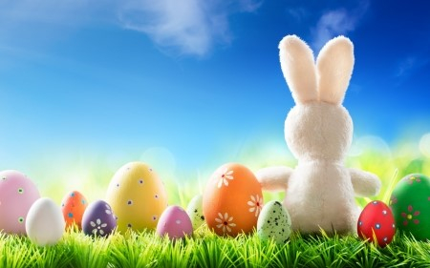
I BELIEVE in God the Father Almighty, Maker of heaven and earth: And in Jesus Christ his only Son our Lord, Who was conceived by the holy Ghost, Born of the Virgin Mary, Suffered under Pontius Pilate, Was crucified, dead, and buried: He descended into hell. The third day he rose again from the dead; He ascended into heaven, And sitteth on the right hand of God the Father Almighty; From thence he shall come to judge the quick and the dead. I believe in the Holy Ghost; The holy Catholic Church; The Communion of Saints; The Forgiveness of sins; The Resurrection of the body, And the Life everlasting. Amen.

Slide 16
responses
The Lord be with you;
And with thy spirit.
Let us pray.
Lord, have mercy upon us.
Christ, have mercy upon us.
Lord, have mercy upon us.

Slide 17
Lord’s Prayer
OUR Father which art in heaven, Hallowed be thy Name, Thy kingdom come, Thy will be done, in earth as it is in heaven. Give us this day our daily bread; And forgive us our trespasses, As we forgive them that trespass against us; And lead us not into temptation, But deliver us from evil. Amen.

Slide 18
Versicles
O Lord, shew thy mercy upon us; And grant us thy salvation.
O Lord, save the Queen; And mercifully hear us when we call upon thee.
Endue thy Ministers with righteousness; And make thy chosen people joyful.
O Lord, save thy people; And bless thine inheritance.
Give peace in our time, O Lord;
Because there is none other that fighteth for us, but only thou, O God.
O God, make clean our hearts within us; And take not thy Holy Spirit from us.
.

Slide 19
Collect of the Day
Collect for Sunday after Easter – Low Sunday
ALMIGHTY Father, who hast given thine only Son to die for our sins, and to rise again for our justification: Grant us so to put away the leaven of malice and wickedness, that we may alway serve thee in pureness of living and truth; through the merits of the same thy Son Jesus Christ our Lord. Amen.

Slide 20
Second Collect
O GOD, from whom all holy desires, all good counsels, and all just works do proceed: Give unto thy servants that peace which the world cannot give; that both our hearts may be set to obey thy commandments, and also that by thee we being defended from the fear of our enemies may pass our time in rest and quietness; through the merits of Jesus Christ our Saviour. Amen.

Slide 21
THIRD Collect together
LIGHTEN our darkness, we beseech thee, O Lord;
and by thy great mercy defend us
from all perils and dangers of this night;
for the love of thy only Son,
our Saviour Jesus Christ. Amen.

Slide 22
MUTE yourself and feel free to join in

Slide 23
Let us pray for the Queen, and all who are set in authority under her throughout her dominions.
V. The King shall rejoice in thy strength, O Lord; R. Exceeding glad shall he be of thy salvation.
ALMIGHTY God, who reignest over the kingdoms of men: We humbly beseech thee to bless our Sovereign Lady, Queen Elizabeth, her Ministers and Parliaments, and all who are set in authority under her throughout her dominions; that they may order all things in wisdom and righteousness, to the honour of thy holy Name, and the good of thy Church and people; through Jesus Christ our Lord. Amen.

Slide 24
Let us pray for the unity of all Christian people.
V. Behold, how good and joyful a thing it is; R. To dwell together in unity.
O GOD the Father of our Lord Jesus Christ, our only Saviour, the Prince of Peace: Give us grace seriously to lay to heart the great dangers we are in by our unhappy divisions. Take away all hatred and prejudice, and whatsoever else may hinder us from godly union and concord: that, as there is but one Body, and one Spirit, and one hope of our calling, one Lord, one Faith, one Baptism, one God and Father of us all, so we may henceforth be all of one heart, and of one soul, united in one holy bond of truth and peace, of faith and charity, and may with one mind and one mouth glorify thee; through Jesus Christ our Lord. Amen.

Slide 25
Let us pray for the extension of Christ’s kingdom throughout the world.
V. How beautiful are the feet of them that preach the gospel of peace; R. And bring glad tidings of good things.
O GOD our heavenly Father, who didst manifest thy love by sending thine only-begotten Son into the world that all might live through him: Pour thy Spirit upon thy Church that it may fulfil his command to make disciples of all the nations; send forth, we beseech thee, labourers into thy harvest; and hasten the time when the fulness of the Gentiles shall be gathered in, and all Israel shall be saved; through the same thy Son Jesus Christ our Lord. Amen.

Slide 26
V. Desire of me, and I shall give thee the heathen for thine inheritance; R. And the utmost parts of the earth for thy possession.
O GOD, who hast made of one blood all nations of men for to dwell on all the face of the earth, and didst send thy blessed Son to preach peace to them that are afar off and to them that are nigh: Grant that the people who sit in darkness and the shadow of death may feel after thee and find thee; and hasten, O Lord, the fulfilment of thy promise to pour out thy Spirit upon all flesh; through Jesus Christ our Lord. Amen.

Slide 27
Let us pray for the sick and suffering.
V. He healeth those that are broken in heart;
R. And giveth medicine to heal their sickness.
ALMIGHTY and immortal God, giver of life and health: We beseech thee to hear our prayers for thy servants for whom we implore thy mercy, that by thy blessing upon them and upon those who minister to them of thy healing gifts, they may be restored, if it be thy gracious will, to soundness of health, and give thanks to thee in thy holy Church; through Jesus Christ our Lord. Amen.
Here may follow any of the Additional Prayers as need may require.

Slide 28
Let us remember before God the faithful departed.
V. The souls of the righteous are in the hand of God;
R. They are in peace.
O ETERNAL Lord God, who holdest all souls in life: We beseech thee to shed forth upon all the faithful departed the bright beams of thy light and heavenly comfort; and grant that they, and we with them, may at length attain to the joys of thine eternal kingdom; through Jesus Christ our Lord. Amen.
We offer our personal prayers in silence

Slide 29
TO God the Father who loved us, and made us accepted in the Beloved; to God the Son, who loved us, and loosed us from our sins by his own blood; to God the Holy Ghost who sheddeth the love of God abroad in our hearts; to the one true God be all love and all glory for time and for eternity. Amen.
The Almighty and merciful God bless and keep us this night, and for evermore. Amen.

Slide 30
MUTE and sing along at home

Slide 31
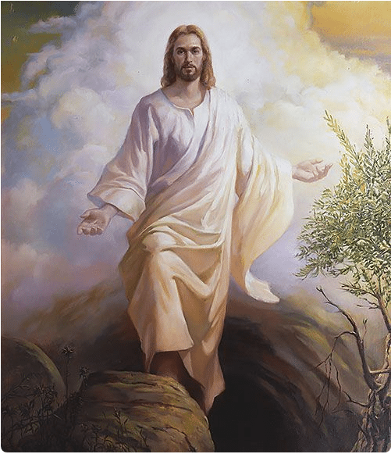
Thank you for joining in Easter 2 Evensong this week is Wednesday 2pm Telephone Church and 7pm Zoom Communion next Sunday 0945 St Johns & 1130 St Margarets & 6pm Evensong www.SECStJohnStMargaret.org.uk
Feel free to go, or stay and chat

