Slide 1
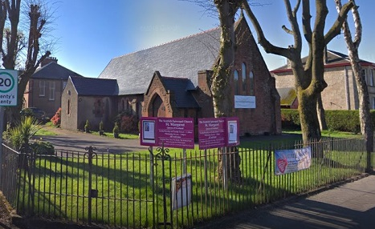
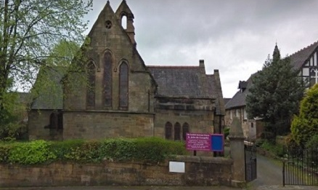
Compline Thursday 1 April 2021 Maundy Thursday
St Johns Johnstone & St Margarets Renfrew
Scottish Episcopal Church
Diocese of Glasgow & Galloway
We gather in silence

Slide 2
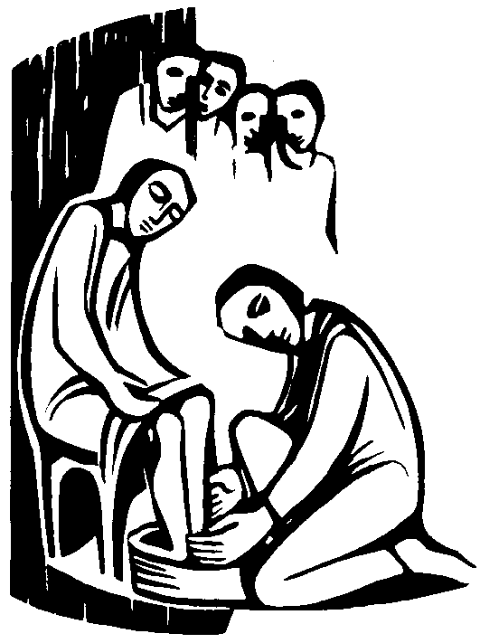
UNMUTE
Welcome to Compline from the Scottish Book of Common Prayer 1929

Slide 3
TURN us, O God our Saviour; And let thine anger cease from us.
The Lord Almighty grant us a quiet night and a perfect end.
.

Slide 4
BRETHREN, be sober, be vigilant; because your adversary the devil, as a roaring lion, walketh about, seeking whom he may devour: whom resist, stedfast in the faith. 1 St. Peter 5. 8, 9.
V. But thou, O Lord, have mercy upon us;
R. Thanks be to God..

Slide 5
Confession
We pause to recollect the day gone by

Slide 6
Confession
WE confess to God Almighty, the Father, the Son, and the Holy Ghost, that we have sinned in thought, word, and deed, through our own grievous fault. Wherefore we pray God to have mercy upon us.
ALMIGHTY God, have mercy upon us, forgive us all our sins and deliver us from evil, confirm and strengthen us in all goodness, and bring us to life everlasting. Amen.

Slide 7
Absolution
MAY the Almighty and merciful Lord
grant unto you pardon
and remission of all your sins,
time for true repentance,
amendment of life,
and the grace and comfort
of the Holy Spirit. Amen.

Slide 8
O God, make speed to save us;
O Lord, make haste to help us.
Glory be to the Father, and to the Son : and to the Holy Ghost;
As it was in the beginning, is now, and ever shall be : world without end. Amen.
Praise ye the Lord
The Lord's Name be praised.

Slide 9
PSALM 134
BEHOLD now, praise the Lord: all ye servants of the Lord;
2 Ye that by night stand in the house of the Lord : even in the courts of the house of our God.
3 Lift up your hands in the sanctuary : and praise the Lord.
4 The Lord that made heaven and earth give thee blessing out of Sion.
Glory be to the Father, and to the Son : and to the Holy Ghost; As it was in the beginning, is now, and ever shall be : world without end. Amen.

Slide 10
Scripture reading – Maundy Thursday John 13.1-15
It was before the festival of the Passover, and Jesus knew that the hour had come for him to pass from this world to the Father. He had always loved those who were his in the world, but now he showed how perfect his love was.
They were at supper, and the devil had already put it into the mind of Judas Iscariot son of Simon, to betray him. Jesus knew that the Father had put everything into his hands, and that he had come from God and was returning to God, and he got up from table, removed his outer garment and, taking a towel, wrapped it round his waist; he then poured water into a basin and began to wash the disciples’ feet and to wipe them with the towel he was wearing.
He came to Simon Peter, who said to him, ‘Lord, are you going to wash my feet?’
Jesus answered, ‘At the moment you do not know what I am doing, but later you will understand.’
‘Never!’ said Peter ‘You shall never wash my feet.’
Jesus replied, ‘If I do not wash you, you can have nothing in common with me.’
‘Then, Lord,’ said Simon Peter ‘not only my feet, but my hands and my head as well!’
Jesus said, ‘No one who has taken a bath needs washing, he is clean all over. You too are clean, though not all of you are.’ He knew who was going to betray him, that was why he said, ‘though not all of you are.’
When he had washed their feet and put on his clothes again he went back to the table. ‘Do you understand’ he said ‘what I have done to you? You call me Master and Lord, and rightly; so I am. If I, then, the Lord and Master, have washed your feet, you should wash each other’s feet. I have given you an example so that you may copy what I have done to you.’

Slide 11
Jesus said, ‘No one who has taken a bath needs washing, he is clean all over. You too are clean, though not all of you are.’
He knew who was going to betray him, that was why he said, ‘though not all of you are.’
When he had washed their feet and put on his clothes again he went back to the table.
‘Do you understand’ he said ‘what I have done to you? You call me Master and Lord, and rightly; so I am. If I, then, the Lord and Master, have washed your feet, you should wash each other’s feet. I have given you an example so that you may copy what I have done to you.’

Slide 12
MUTE - sing along with the hymn

Slide 13
A Reflection for Maundy Thursday

Slide 14
The Responses
V. Keep me as the apple of an eye;
R. Hide me under the shadow of thy wings.
Anthem. Save us, O Lord, while waking, and defend us while sleeping : that when we are awake we may watch with Christ, and when we sleep we may rest in peace.

Slide 15
Nunc Dimittis
St. Luke 2. 29.
LORD, now lettest thou thy servant depart in peace : according to thy word.
2 For mine eyes have seen : thy salvation;
3 Which thou hast prepared : before the face of all people;
4 To be a light to lighten the Gentiles : and to be the glory of thy people Israel.
Glory be to the Father, and to the Son : and to the Holy Ghost;
As it was in the beginning, is now, and ever shall be world without end. Amen.
Save us, O Lord, while waking, and defend us while sleeping : that when we are awake we may watch with Christ, and when we sleep we may rest in peace.

Slide 16
The Apostles Creed
I BELIEVE in God the Father Almighty, Maker of heaven and earth:
And in Jesus Christ his only Son our Lord, Who was conceived by the Holy Ghost, Born of the Virgin Mary, Suffered under Pontius Pilate, Was crucified, dead, and buried: He descended into hell; The third day he rose again from the dead; He ascended into heaven, And sitteth on the right hand of God the Father Almighty; From thence he shall come to judge the quick and the dead.
I believe in the Holy Ghost; The holy Catholic Church; The Communion of Saints; The Forgiveness of sins; The Resurrection of the body, And the Life everlasting. Amen.

Slide 17
The Prayers
Lord, have mercy upon us. Christ, have mercy upon us. Lord, have mercy upon us.
OUR Father which art in heaven, Hallowed be thy Name, Thy kingdom come, Thy will be done, in earth as it is in heaven. Give us this day our daily bread; And forgive us our trespasses, As we forgive them that trespass against us; And lead us not into temptation, But deliver us from evil. Amen.

Slide 18
The responses
Blessed art thou, Lord God of our fathers;
To be praised and glorified above all for ever.
Let us bless the Father, the Son, and the Holy Ghost;
Let us praise him and magnify him for ever.
Blessed art thou, O Lord, in the firmament of heaven;
To be praised and glorified above all for ever.
The Almighty and most merciful Lord guard us and give us his blessing;
Amen.

Slide 19
2. The responses
Wilt thou not turn again and quicken us;
That thy people may rejoice in thee?
O Lord, shew thy mercy upon us;
And grant us thy salvation.
Vouchsafe, O Lord, to keep us this night without sin;
O Lord, have mercy upon us, have mercy upon us.
O Lord, hear our prayer;
And let our cry come unto thee.

Slide 20
The collects
Let us pray.
LIGHTEN our darkness, we beseech thee, O Lord; and by thy great mercy defend us from all perils and dangers of this night; for the love of thy only Son, our Saviour Jesus Christ. Amen.
LOOK down, O Lord, from thy heavenly throne, illuminate the darkness of this night with thy celestial brightness, and from the sons of light banish the deeds of darkness; through Jesus Christ our Lord. Amen.

Slide 21
Collects…..
BE present, O merciful God, and protect us through the silent hours of this night, so that we who are wearied by the changes and chances of this fleeting world may repose upon thy eternal changelessness; through Jesus Christ our Lord. Amen.
O LORD, support us all the day long of this troublous life, until the shades lengthen, and the evening cometh, and the busy world is hushed, the fever of life is over, and our work done. Then, Lord, in thy mercy, grant us safe lodging, a holy rest, and peace at the last; through Jesus Christ our Lord. Amen.

Slide 22
Collects………..
O LORD Jesus Christ, Son of the living God, who at the hour of Compline didst rest in the sepulchre, and didst thereby sanctify the grave to be a bed of hope to thy people: Make us so to abound in sorrow for our sins, which were the cause of thy passion, that when our bodies lie in the dust, our souls may live with thee; who livest and reignest with the Father and the Holy Spirit, ever one God, world without end. Amen.

Slide 23
Closing prayers………..
VISIT, we beseech thee, O Lord, this habitation, and drive far from it all the snares of the enemy. Let thy holy angels dwell herein to preserve us in peace, and may thy blessing be upon us evermore; through Jesus Christ our Lord. Amen.
V. We will lay us down in peace and take our rest; R. For it is thou, Lord, only that makest us dwell in safety. V. Let us bless the Lord; R. Thanks be to God.
THE Almighty and merciful Lord, Father, Son, Land Holy Ghost, bless and keep us. Amen.

Slide 24
Closing music……….. One Bread, One Body written by St Louis Jesuits, sung by Marilla Ness
Please depart to rest in silence when the music finishes the zoom room will be closed

